Slide 1
Hypothesis testing

Slide 2
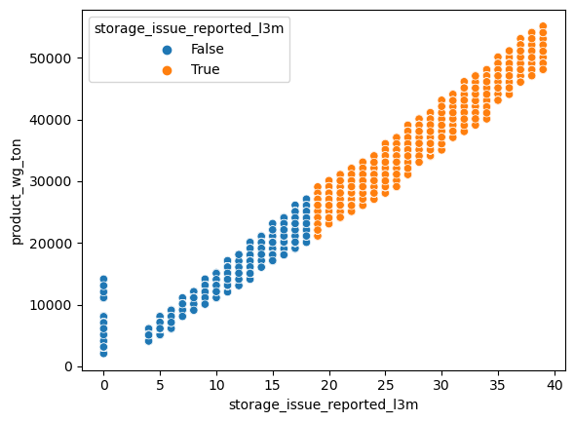
Storage issue in last 3 months
Null hypothesis(H0): p-value > 0.05, no correlation between storage issue and product weight.
Alternate hypothesis(H1): If p-value < 0.05, there is a correlation between storage issue and product weight.
Correlation coefficient: 0.98 p-value: 0.0
This may be due to overstocking, poor inventory
management.

Slide 3
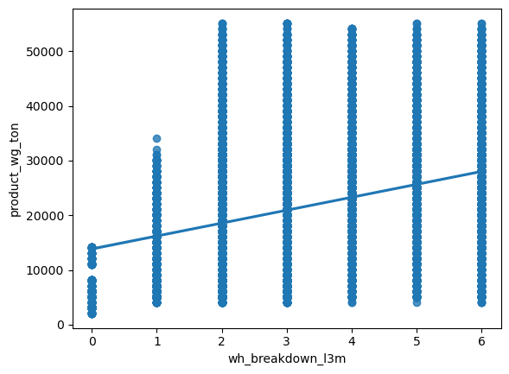
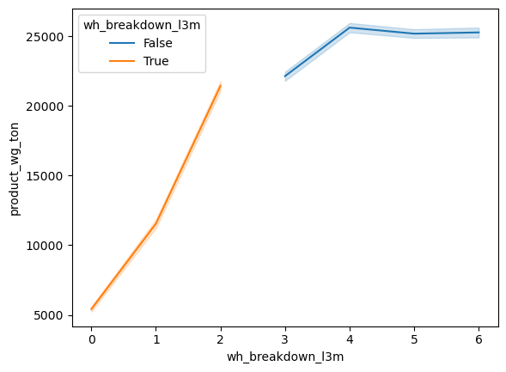
Warehouse breakdown in last 3 months
Null hypothesis(H0): If p-value > 0.05 then there is no correlation between warehouse breakdown and weight.
Alternate hypothesis(H1): If p-value < 0.05 then there is correlation between warehouse breakdown and weight.
Correlation coefficient: 0.34 p-value: 0.0
This may be due to bad inventory management, poorly organized workflow, lack of damage control.

Slide 4
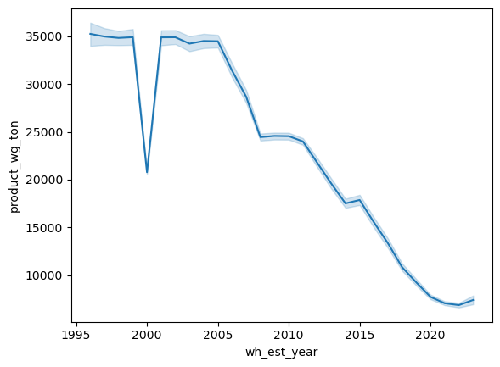
Warehouse established year
Null hypothesis: p-value > 0.05, then there is no correlation between established year and weight.
Alternate hypothesis: p-value < 0.05, then there is correlation between established year and weight.
Correlation coefficient: -0.35
p-value: 0.0
As warehouse established year increases weight of product is decreasing.
It may be due to low popularity hence low sales in newly established regions

Slide 5
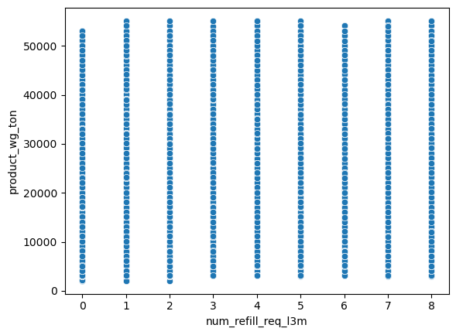
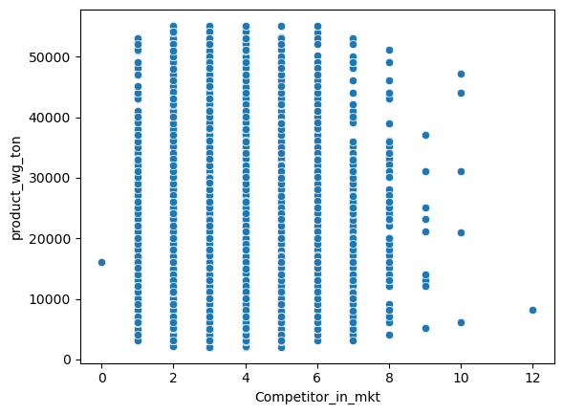
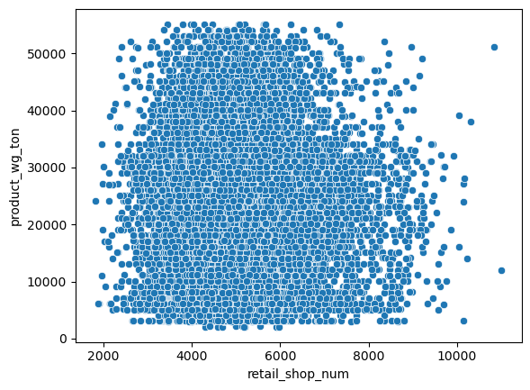
No fo refills in last 3 months: r = 0.000675, p-value = 0.91
Competitors in market : r = 0.007, p-value = 0.278
Retail shop numbers : r = -0067, p-value = 0.31

Slide 6
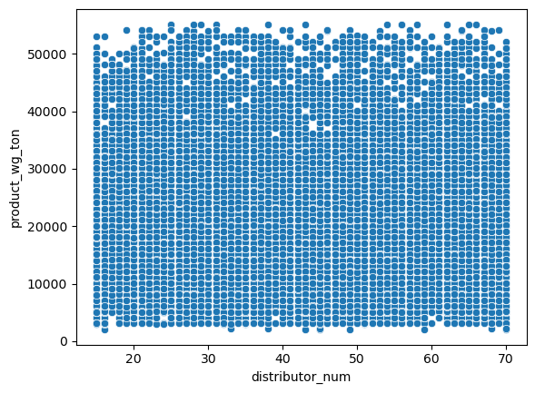
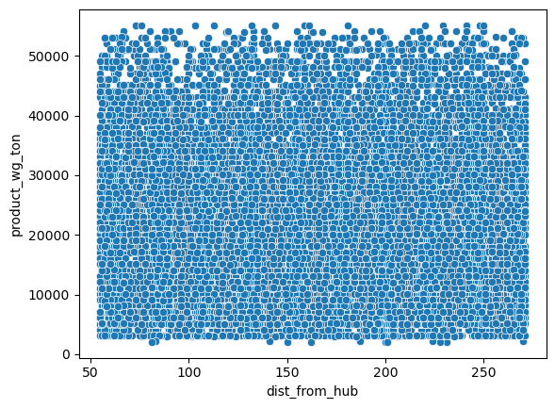
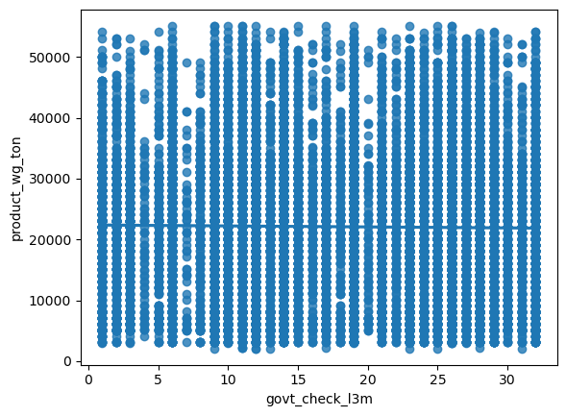
Number of distributors : r = 0.005, p –value = 0.44
Distance of warehouse from Production hub : r = -0.006, p-value = 0.37
Government checkup of warehouse in last 3 months : r = -0.019, p-value = 0.075

Slide 7
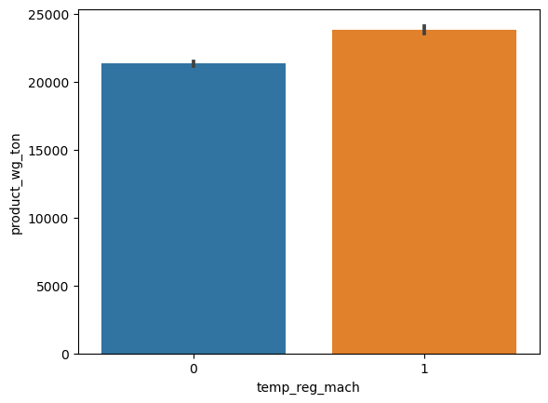
Temperature regulating machine
Null hypothesis(H0): μ1 = μ2, there is no relation between temperature regulating machine and weight.
Alternate hypothesis(H1): μ1 ≠ μ2 there exists a relation between temperature regulating machine and weight.
F one way Result( p- value ~ 0)
Hence the difference in product is seen with and without temperature regulating machine

Slide 8
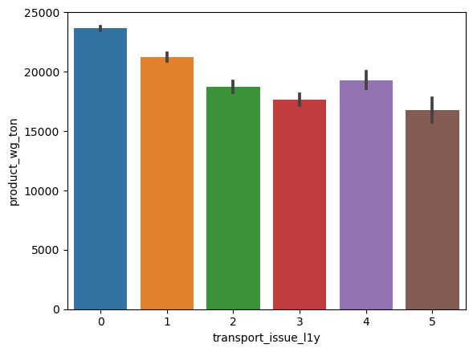
Transport issues in last 1 year
μ1, μ2, μ3, μ4, μ5 , μ6 for transport issues for 0,1,2,3,4,5 number of times. Anova is suitable here.
Null hypothesis(H0): μ0 = μ1 = μ2 = μ3 = μ4 = μ=5
Alternate hypothesis(H1): Anyone of the means are unequal
F – one way result: p – value ~ 0

Slide 9
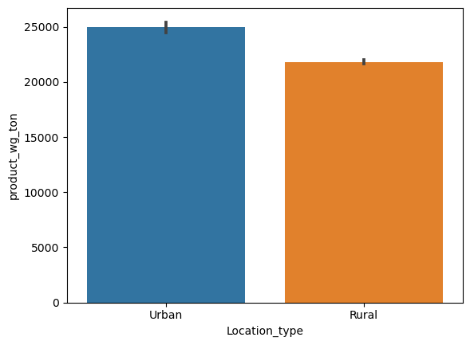
warehouse location type
Null hypothesis(H0): μ1 = μ2, there is no relation between location and weight.
Alternate hypothesis(H1): μ1 ≠ μ2, there exists a relation between location and weight.
F – one way result: p – value ~ 0
Hence there is a difference in urban and rural weights of products

Slide 10
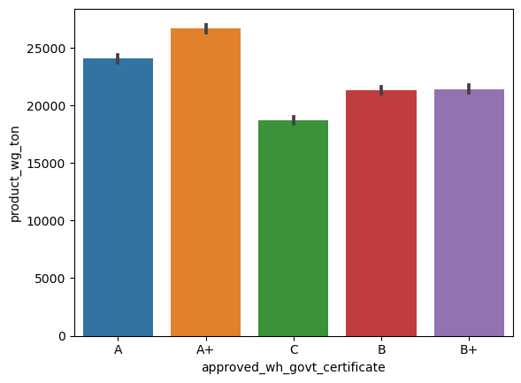
Approved govt certificate of warehouse
Null hypothesis(H0): μ1(A+) = μ2(A) = μ3(B+) = μ4(B) = μ5(C), there is no relation between govt certificate and weight of product.
Alternate hypothesis(H1): Anyone one of the means are unequal, there exists relationship.
F – one way result: p – value ~ 0
Hence warehouses having high grade, approved by govt have higher weights.

Slide 11
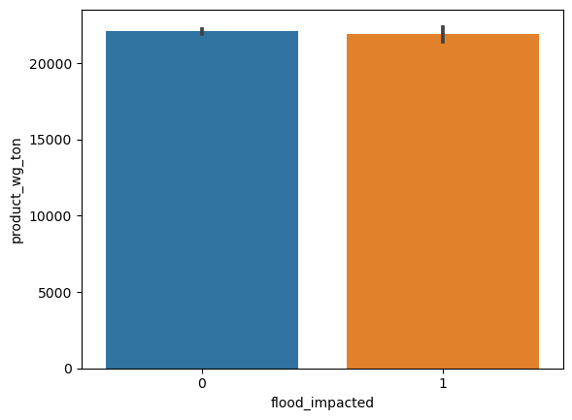

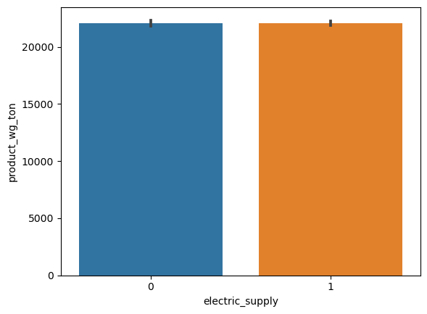
Flood impacted area : T- test : p-value = 0.44 , ( > 0.05)
P-value hence, fail to reject null hypothesis , Hence flood impact has no effect on weight of product.
Flood proof warehouse : T- test : p-value = 0.59 , ( > 0.05)
p-value > 0.05 hence, fail to reject null hypothesis, There no relationship between flood proof and weight of noodles
Electric supply : T- test : p-value = 0.91 , ( > 0.05)
P value > 0.05, hence fail to reject null hypothesis, There is no relationship between electric supply and weight of product

Slide 12
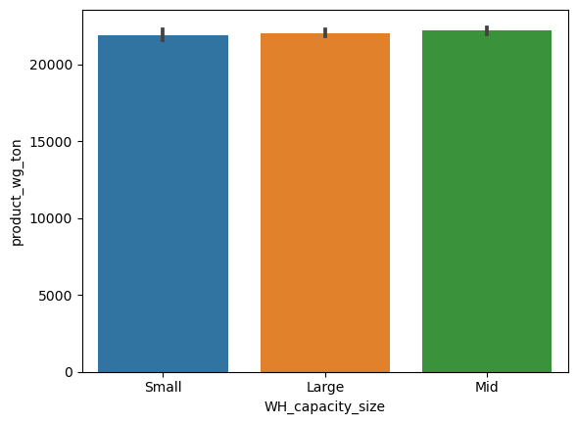
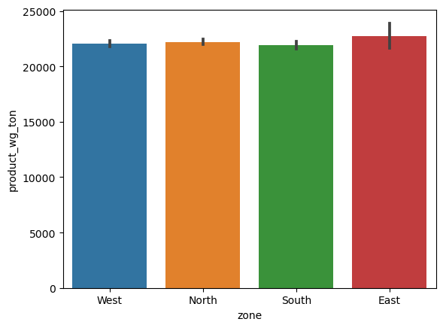
Warehouse capacity size : F –one way result : p-value = 0.39
P-value > 0.05,fail to reject null hypothesis, There is no relation between warehouse size and weight of product
warehouse zone : F –one way result : p-value = 0.275 > 0.05
There is no relation between warehouse zone and weight of Product.

Slide 13
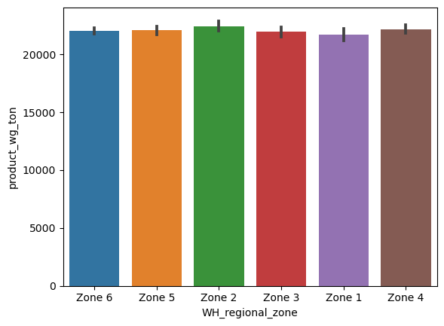
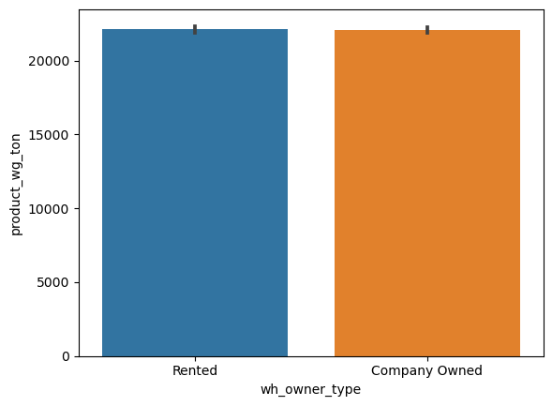
Warehouse regional zone : F – one way result : p-value = 0.4 > 0.05
There is no relation between warehouse regional zones and weight of product.
Warehouse owner type : F – one way result : p-value = 0.6 > 0.05
There is no relation between warehouse owner type and weight of product.

